Slide 1
Bike Sharing Demand

Slide 2
Problem Statement
Bike sharing systems are a means of renting bicycles
Using these systems, people are able rent a bike from a one location and return it to a different place
Currently, there are over 500 bike-sharing programs.

Slide 3
Goals of project
System must predict the total count of bikes rented during each hour
Using only information available prior to the rental period.

Slide 4
DataSet Key features
We have hourly rental data spanning two years.
For this project, the training set is comprised of the first 19 days of each month,
the test set is the 20th to the end of the month

Slide 5
DataSet attributes
datetime - date + hourly timestamp
season - 1 = spring, 2 = summer, 3 = fall, 4 = winter
holiday - whether the day is considered a holiday
workingday - whether the day is neither a weekend nor holiday

Slide 6
weather -
1: Clear, Few clouds, Partly cloudy, Partly cloudy
2: Mist + Cloudy, Mist + Broken clouds, Mist + Few clouds, Mist
3: Light Snow, Light Rain + Thunderstorm + Scattered clouds, Light Rain + Scattered clouds
4: Heavy Rain + Ice Pallets + Thunderstorm + Mist, Snow + Fog
temp - temperature in Celsius
atemp - "feels like" temperature in Celsius

Slide 7
humidity - relative humidity
windspeed - wind speed
casual - number of non-registered user rentals initiated
registered - number of registered user rentals initiated
count - number of total rentals

Slide 8
Data Prepocessing
Data Types:
Categorical Data:
season
holiday
working day
Weather

Slide 9
Numeric
temp
atemp
humidity
windspeed
casual
registerred
count

Slide 10
DateTime Column (datetime)
Date time is divided into 4 columns
day (Day Of year) from 0 to 364
month (month of year) from 1 to 12
dayofweek from 0 to 6
hours from 0 to 23
These are Categorical Types

Slide 11
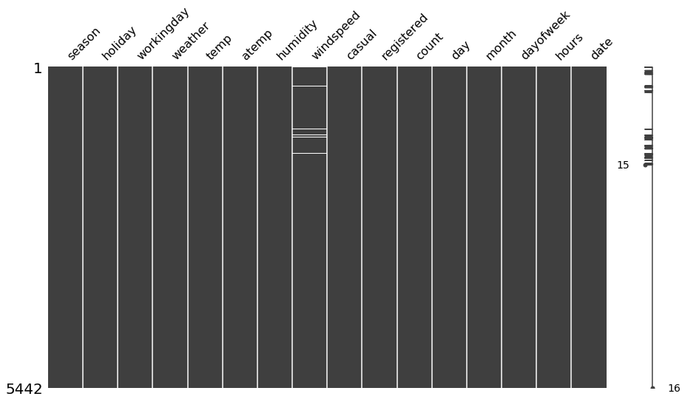
Missing Values

Slide 12
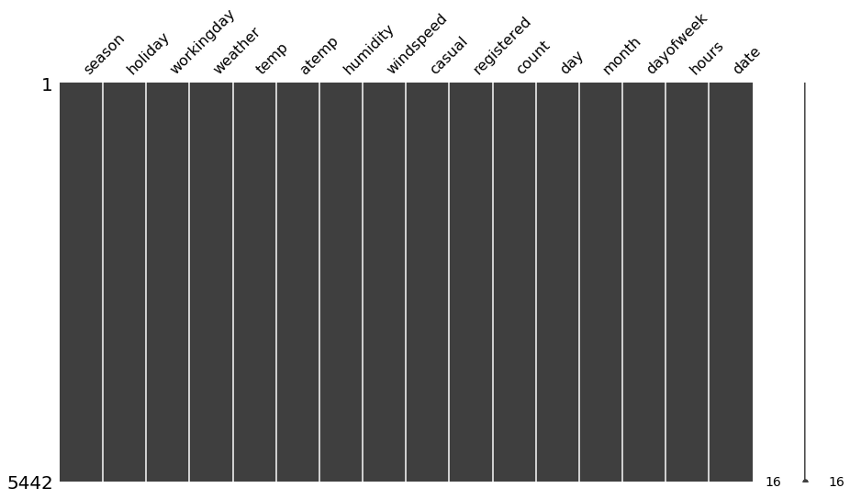
After Replacing Missing Values

Slide 13
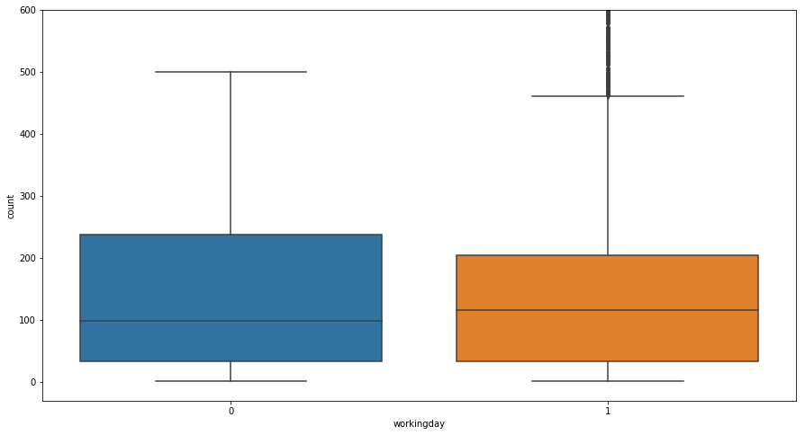
Outliers Detection

Slide 14
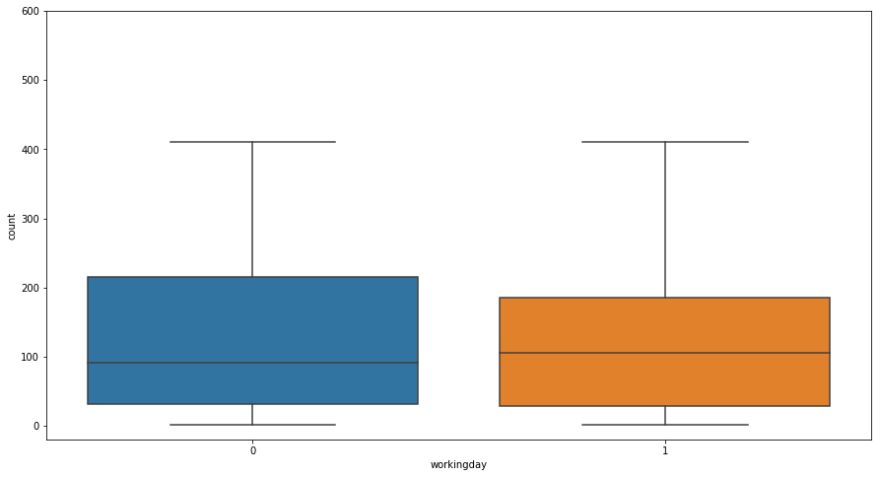
Removing Outliers From Working Day

Slide 15
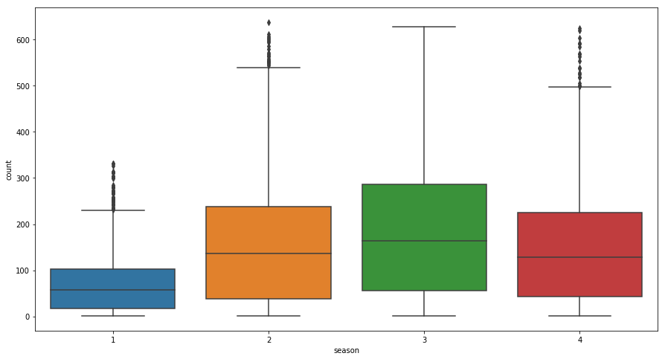
Outliers in Season

Slide 16
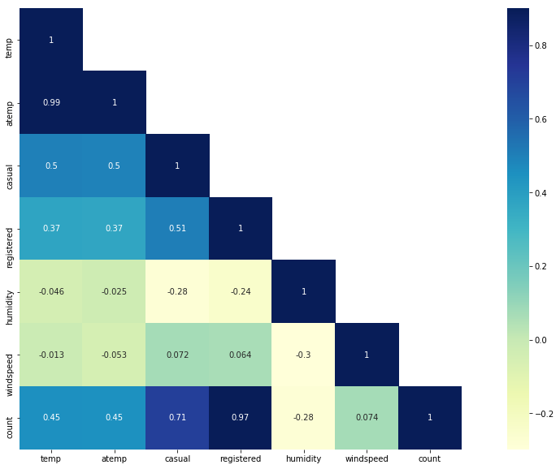
Data Analysis: Correlation

Slide 17
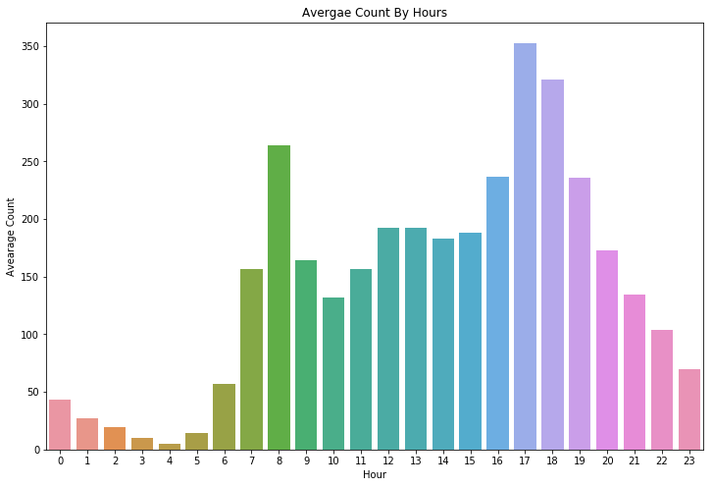
Average Count Every Hour

Slide 18
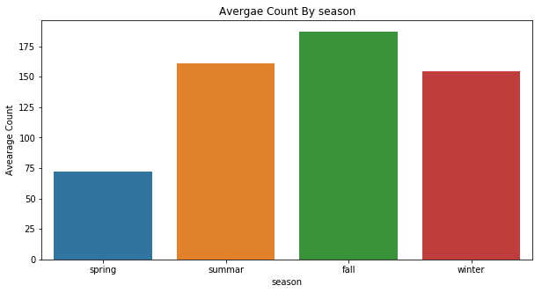
Average Count By Season

Slide 19
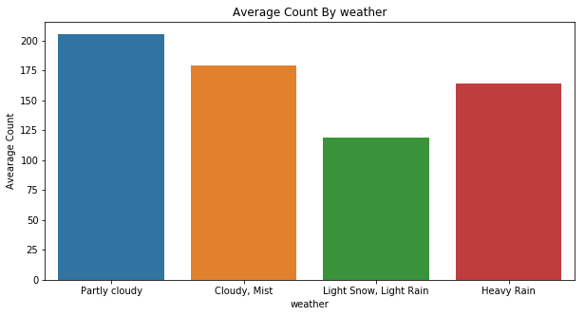
Average Count By Weather

Slide 20
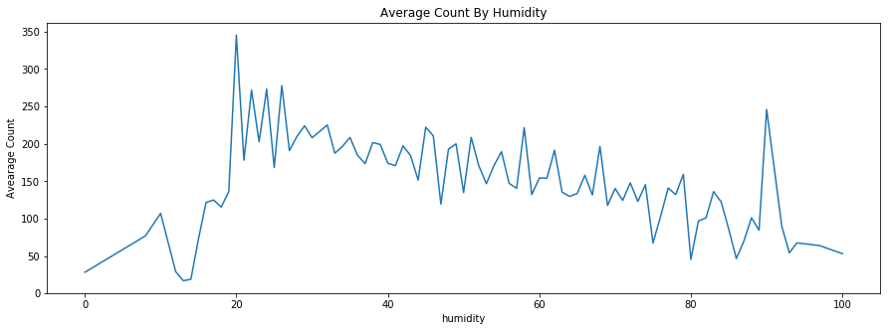
Average Count By Humidity

Slide 21
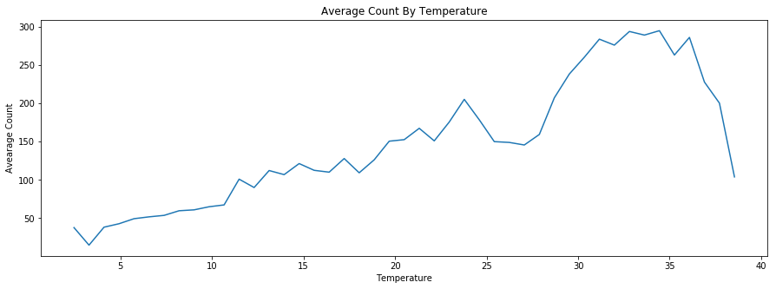
Average Count By Temperature

Slide 22
Final Features for Modeling
day
month
dayofweek
hour
season
holiday
workingday
weather
temp
humidity
windspeed

